Slide 1


Gun violence in
USA 2013-2018
Presentation By
Nikhil Akkaldevi
Ramandeep Kaur
Keerthy Krishnan

Slide 2
Open data source
The database used for visualization was picked from https://www.kaggle.com/jameslko/gun-violence-data Kaggle.
Kaggle is an open data source which has been helpful to many students to get data to work on
The data available is from January 2013 to march 2018
It consists of most of the incidents recorded of around 260k that happened in the United States of America

Slide 3


Slide 4
Gun violence in the united states of America 2013-2018
We have witnessed plenty of gun involved violence in the United states.
There has been many injuries and death due to these incidents.
Men, women, adults, teens and children are equally involved in such incidents.
We shall look into the pattern of gun violence that happened in the united states from 2013 to 2018

Slide 5
Count of the injuries that happened in each state
Illinois has seen the most injuries with over 13,514 been injured.
Wyoming is the state with the least injuries that has seen about 52 people injured.
Comparing Illinois with California we see that the injuries is almost half
A treemap used to show the difference in each state

Slide 6
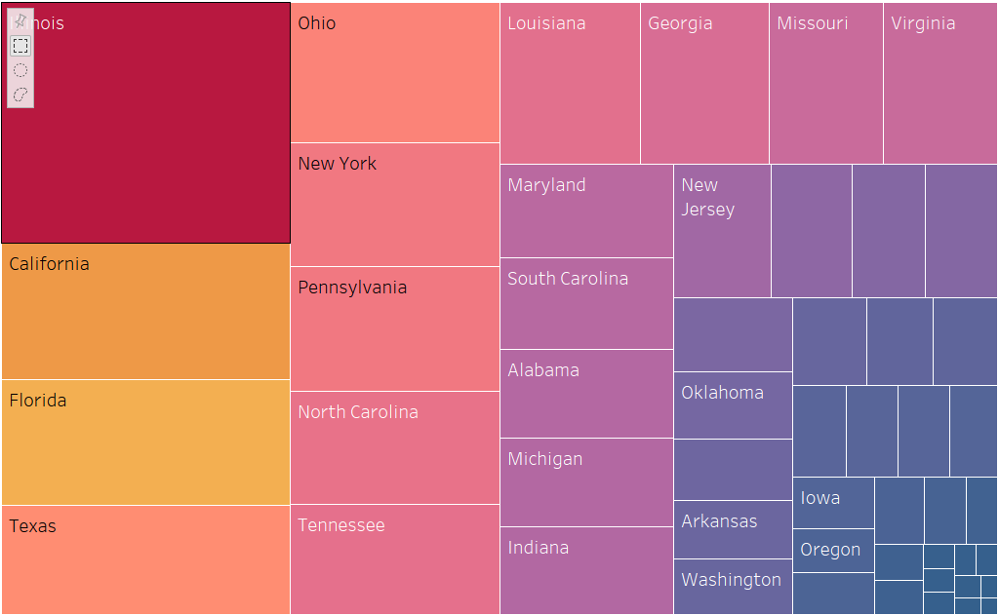

Slide 7
Crime rate pattern from 2013 to 2018
The crime rate has been increasing at a great extent.
The number of records in the year 2013 were around 238 while the number of crimes recorded is 71,221 as of March 2018.
A time series forecasting is used to forecast the crime rate in the year 2019.
It is forecasted to increase

Slide 8
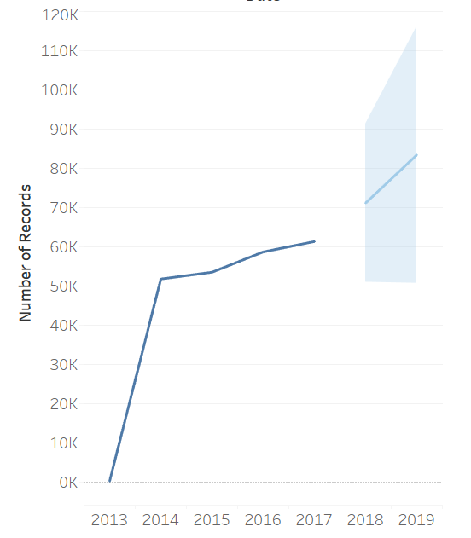
Crime rate pattern
2013-2019

Slide 9
Places with most gun involved violence
California is the place where the most gun involved incidents has been recorded.
Hawaii is the place where the least gun related violence has been recorded

Slide 10
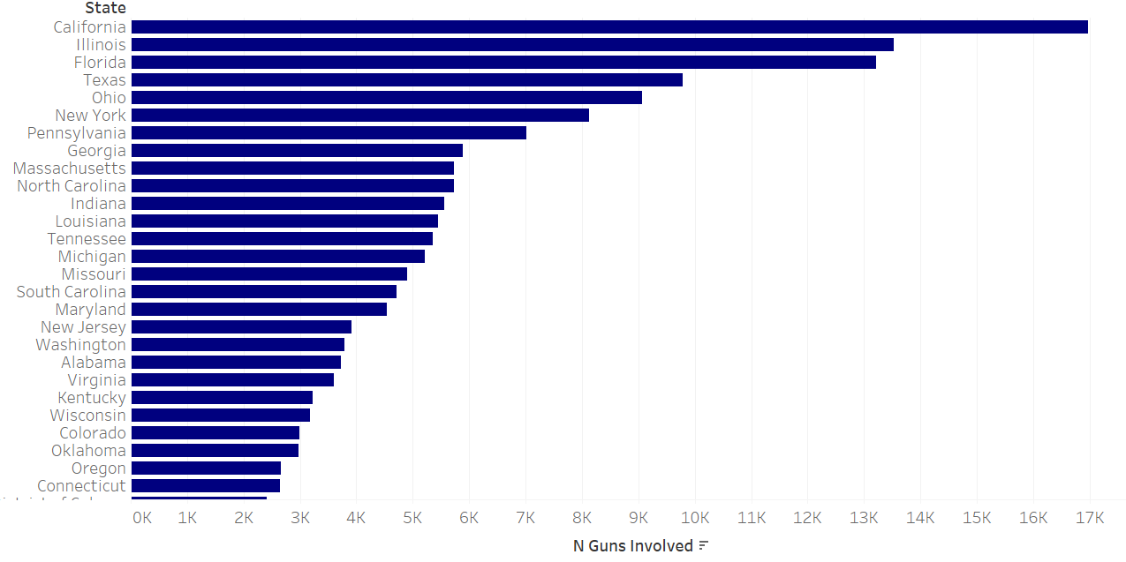
Places with most gun involved violence

Slide 11
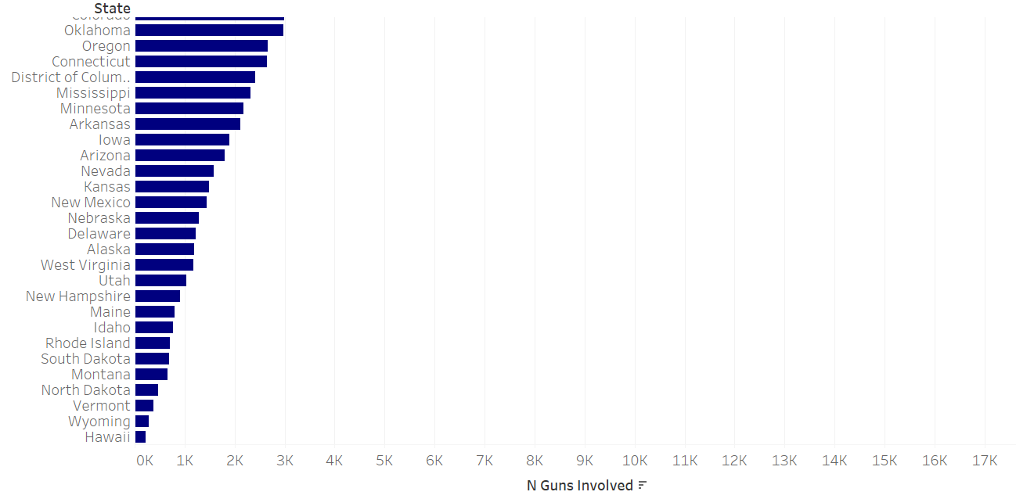
Places with most gun involved violence Continued

Slide 12
Number of people killed during the shooting
The pattern of the number killed is not in proportion to the number of incidents
The number was less in the year 2013 and there was a considerable increase over the years until 2017
Since the data used is only up to the March
With the help of forecast, we see that there is only going to be an increase in the number of people getting killed in such incidents

Slide 13
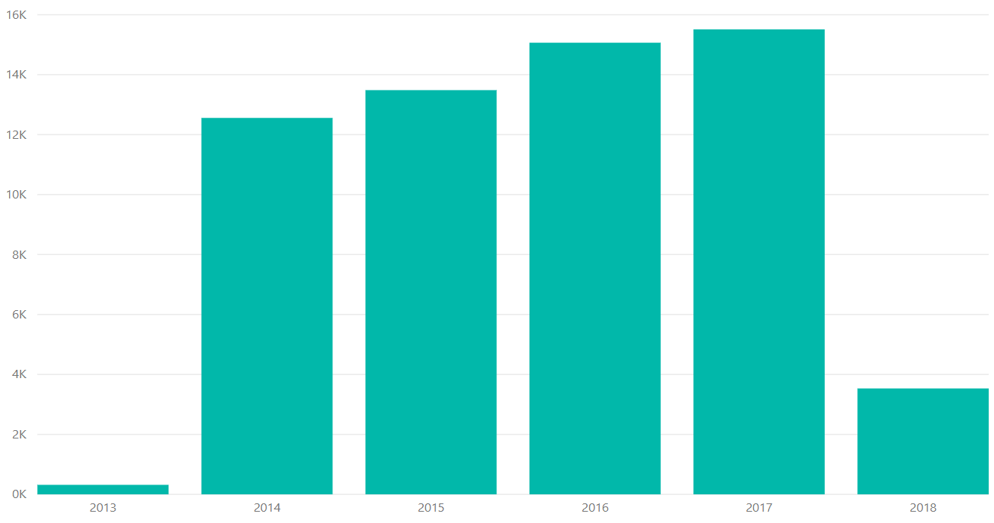

Slide 14
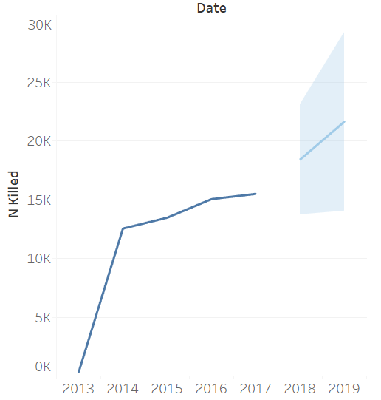
Forecast of number of people killed in the gun violence in the usa

Slide 15
conclusion
The crime rate is forecasted to increase in the year 2019
The number of people getting killed also is forecasted to increase in the year 2019
Stricter laws should be enforced when it comes to gun licenses and its usage

Slide 16

Thank you
Thank you

